Slide 1
Teacher Education a Key Element of Successful Educational Systems
Erno Lehtinen

Slide 2
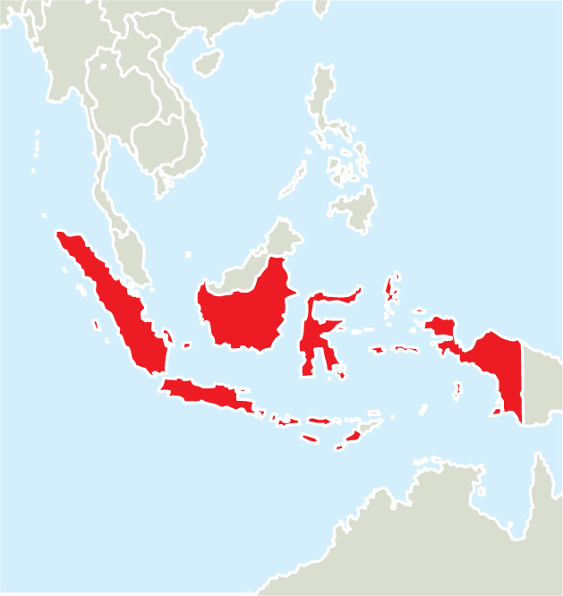
Current state of the Indonesian Education
International evaluation reports
OECD (2015)
World Bank (2013)
National discussion: awareness of the challenges
National plans for enhancement of the system

Slide 3
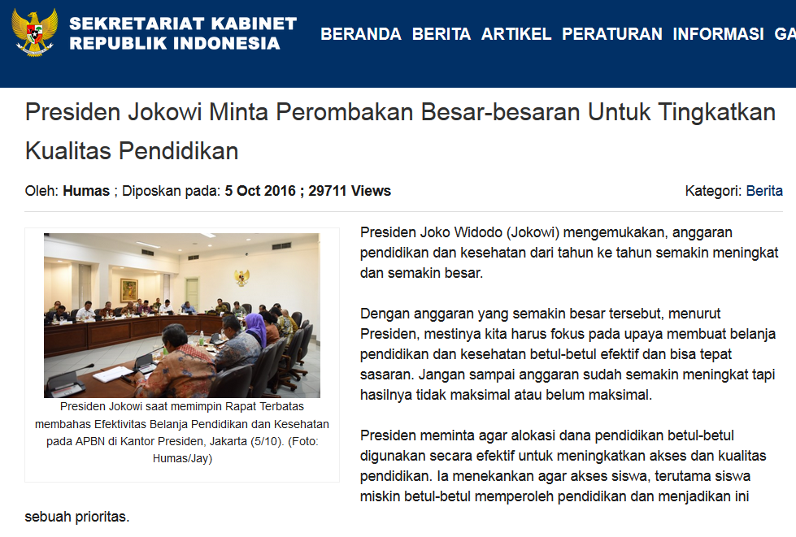

Slide 4
With the increased budget, according to the President, we should focus on efforts to make education and healthcare truly effective and well targeted. …
The President asked that the allocation of education funding should be used effectively to improve access and quality of education. …

Slide 5
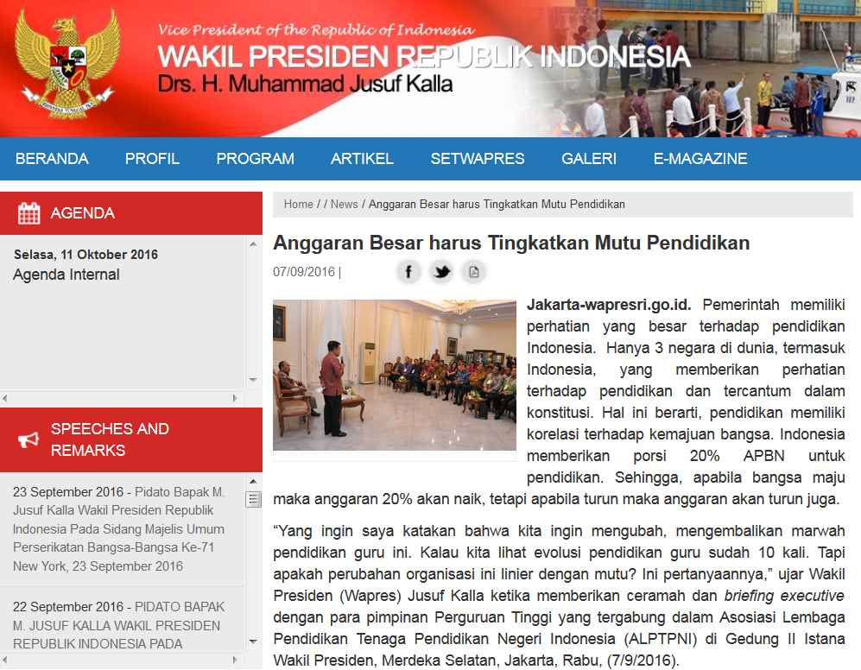

Slide 6
The government has payed great attention to education in Indonesia. …
“I want to say that we want to change, restore the dignity of the teacher education. If we look at the evolution of teacher education there have bee a lot of changes. However, are these organizational changes resulting in improvement of the quality? This is the question, "said Vice President (VP) Jusuf Kalla

Slide 7
The question of the quality of teacher education asked by Vice President Jusuf Kalla is also the question we are dealing with in these two presentations.
We are going to deal with the question of teacher education quality by using the lessons learned from the Finnish experience.

Slide 8
Why Finnish experience is relevant for the education development in Indonesia?
In comparison with Indonesia the population in Finland is very small, 5 and half million inhabitants
But Finland is also a big country, one of the biggest in Europe (about the same size as Germany)

Slide 9
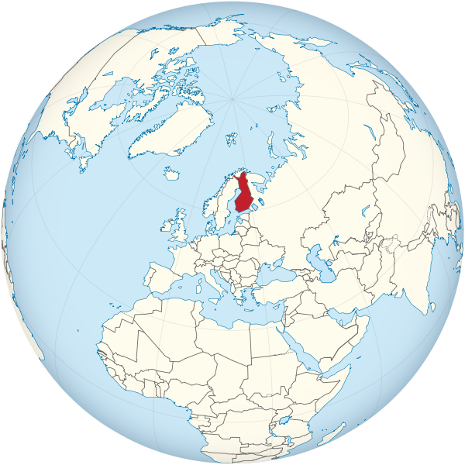

Slide 10
Why Finnish experience is relevant for the education development in Indonesia?
Long distances from the capital (Helsinki) to the northern parts of the country
Remote areas: isolated villages in Lapland (north) and in archipelago (south-west) with its more than 20 000 islands

Slide 11
Why Finnish experience is relevant for the education development in Indonesia?
In the first half of the 20th century and still after the World War 2 Finland was one of the poorest countries in Europe

Slide 12
Why Finnish experience is relevant for the education development in Indonesia?
In international comparison studies in 1970’s and 1980’s Finnish students’
achievement in reading, mathematics and science was about average or even below average within OECD countries

Slide 13
Why Finnish experience is relevant for the education development in Indonesia?
Big educational reforms in 1970’s
9-year join comprehensive school for all students
Strong emphasis on educational equity
New university based teacher education
Master degree for all teachers since 1979
Continues development 1980 –
-Strong emphasis on pedagogical quality, deep learning and self-regulation skills
- Evidence based development

Slide 14
Why Finnish experience is relevant for the education development in Indonesia?
Dramatic change in the achievement in international comparison studies (IEA, SIMSS, TIMSS, PISA etc.)
Finland
OECD average
1970
1980
1990
2000
2015

Slide 15
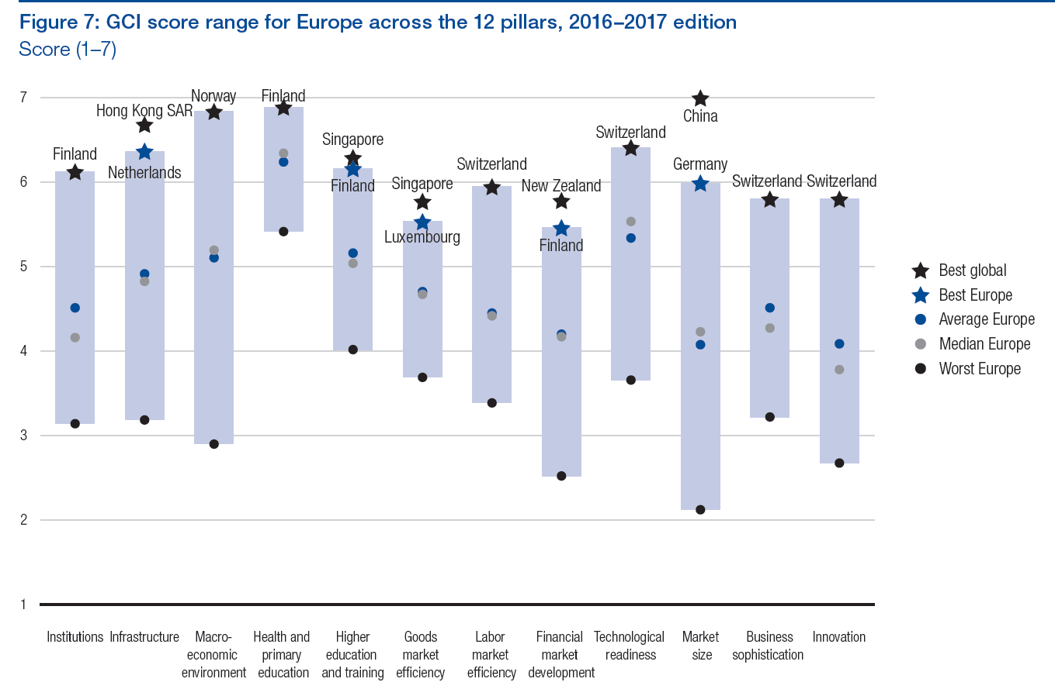
World Economic Forum: The Global Competitiveness Report 2016–2017

Slide 16
Institutions
World Economic Forum: The Global Competitiveness Report 2016–2017

Slide 17
Health and primary education
World Economic Forum: The Global Competitiveness Report 2016–2017

Slide 18
Higher education and training
World Economic Forum: The Global Competitiveness Report 2016–2017

Slide 19
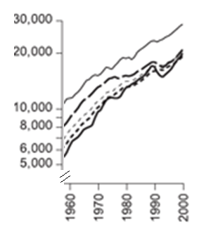
Gross Domestic Product per Capita of Finland and European Countries
Sweden
Western Europe average
Finland

Slide 20
Gross Domestic Product per Capita of Finland and European Countries
Continuous evidence based development
Comprehensive school and teacher education reform
Finland

Slide 21
What is the impact of teacher education?
Large studies in many countries have shown that just increasing the number of teacher certificates does not necessarily have a big impact on teaching quality and students learning ( For example the 2013 World Bank study of Indonesian education).

Slide 22
What is the impact of teacher education?
It is the quality of teacher education which matters!

Slide 23
High level teacher education makes a difference
Practically all teachers in Finland had a teacher certificate already before 1970’s but there was a need for quality improvement
Finland
OECD average
1970
1980
1990
2000
2015

Slide 24
High level teacher education makes a difference
Finland
Start of the new teacher education
OECD average
1970
1980
1990
2000
2015

Slide 25
High level teacher education makes a difference
Teachers graduated from the new high quality teacher programs became the majority of teaching stuff in schools in 1990’s
Finland
Start of the new teacher education
OECD average
1970
1980
1990
2000
2015

Slide 26
Co-creation of an Quality Enhancement Project for Indonesian Teacher Education

Slide 27
Co-creation of an Quality Enhancement Project for Indonesian Teacher Education
Finland University is a consortium of three Finnish universities: University of Eastern Finland, University of Tampere and University of Turku, all belonging to the top 1 or 2 percent of the world universities.
Together with Indonesian experts Finland University has prepared a plan of a collaborative development project for quality enhancement in Indonesian teacher education

Slide 28
Enhancement project: First step
A four year project in close collaboration with 12 universities
Critical challenges:
Structure of the teacher education
Curriculum of the teacher education
Capacity of the teacher education model
PPG curriculum of student centered teacher education leading to responsible learners
Competence development program in PPGs
Model and criteria for Training Schools (partner and labschools)
Competence development program in Teacher Training Institutions
A scaling-up model which make it possible to educate over 5000 teacher educators, who support 200 000 new teachers, who will start teaching millions of students

Slide 29
Enhancement project: Second step
Core universities act as Training and Innovation Centers for the whole Indonesian educational system and teacher education scaling up the models further to the whole country
Sustainable collaboration between Finland University and the Indonesian teacher education actors
Joint research units providing solid scientific evidence for the continuous development of the educational processes in Indonesia

Slide 30
Key principles of the high quality teacher education
Focus on adaptive expertise
Focus on pedagogical knowledge and scientific evidence
Focus on content knowledge and pedagogical content knowledge
Focus on deliberate practice
Focus on ethical professionalism

Slide 31
Focus on adaptive expertise
Preparing teacher students for the changing world:
From routine practice towards adaptive and flexible skills enabling clever activities in novel situations
From static profession to continuous self directed and collaborative development of teaching expertise

Slide 32
Focus on pedagogical knowledge and scientific evidence
Student centered teaching in a responsible way is demanding
Knowledge base for understanding students’ motives, prior knowledge, and learning processes
Knowledge base needed in organizing learning environments and in guiding students learning processes
Deep pedagogical and educational psychology knowledge about students and learning environments is a necessary basis for high quality teaching
Understanding the role of scientific evidence and skills to find and make use of evidence in teacher work.
This enables continuous professional development

Slide 33
Focus on content knowledge and pedagogical content knowledge
Teachers need deep understanding of the content knowledge they teach. They should be able to support students in approaching the content knowledge from different viewpoints and in building connections between concepts.
Content knowledge or general pedagogical knowledge is not enough. Techers should also have pedagogical content knowledge, which makes it possible to understand:
What prior knowledge students need for construction the new concepts
What is specific for learning certain concepts and skills
How prior knowledge and everyday beliefs can hinder learning of new concepts and skills

Slide 34
Focus on deliberate practice
Just practice in a classroom is not enough for high quality teacher education
What is needed for the development of adaptive expertise in teaching is deliberate practice:
Students own engagement in developing continuously better skills to understand students and organize teaching
High quality guidance and detailed feedback from an experienced teacher or teacher educator
Systematic focusing on the different aspects of the professional skills and continuous self reflection and evaluation of own progress and weaknesses

Slide 35
Focus on ethical professionalism
Teacher profession is not only a collection of skills needed in classroom teaching but teachers have many other responsibilities in supporting the students’ personal development and also the local civil society
Teacher students have to learn what is the role of schools and teachers in society and what are the ethical requirements of teacher profession

Slide 36
Thank you for your attention!

